Slide 1

Contact Manager
Group 5

Slide 2
What our project is about?
A convenient solution to managing all your contacts in one location.
Ability to easily create an account.
Create a new contact by providing important information like address, phone number, etc.
Search through your contact list.
Update contact information.
Delete old or not needed contacts.

Slide 3
Who we Are and Our Roles:
Muhammad Abdallah Bin Alli (API)
Nguyen Thuy An Do (Database/API)
Umran Syed Jameel (API)
Emilio Daniel Morales (Front End)
Natali Siam-Pollo (Project Manager/Front End)

Slide 4
What went Right and Wrong:
Successes!
Ability to learn a functional skill and multiple languages over a short period of time.
Everyone collaborated effectively to achieve our goals and deadlines.
Communicated what was needed from different roles and created overlap.
Wrong/Weaknesses:
We didn’t create a Use Case diagram early enough into our project to determine what was needed for our web development.
Initially we weren’t extremely involved in other roles, besides our own. This caused issues when trying to connect our different portions of the project together.

Slide 5
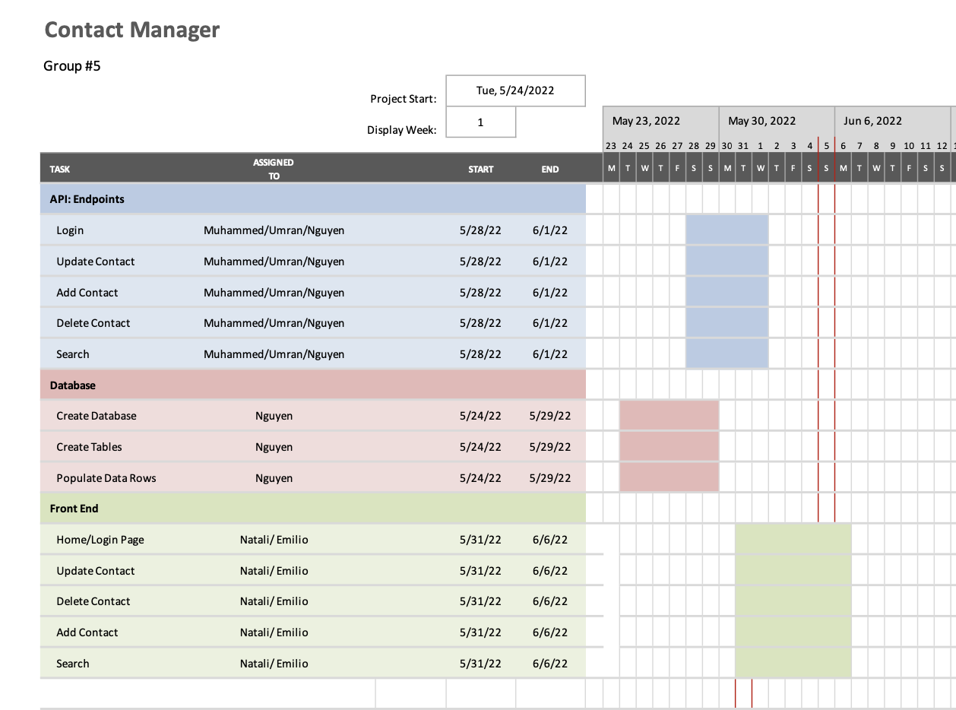
Gantt Chart

